Slide 1

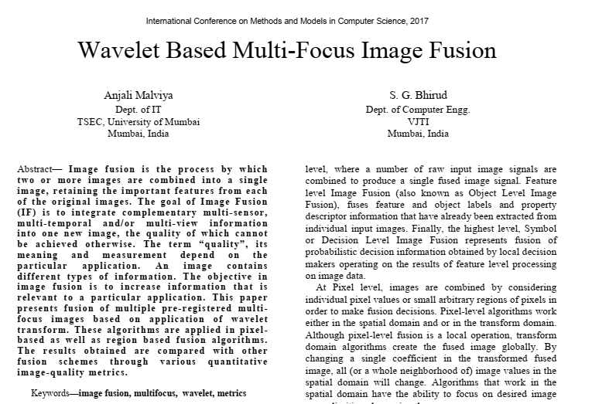
Image Fusion via Wawelet Transform
Gathered by Sadegh Jamishi

Slide 2
Outline
Introductoin
Primary kinds of Image fusion
Image fusion algorithms
Wavelet Algorithms
Algorithm Realization and Implementation
Result and Performance Analysis
Comparison of Author Output Result with Mine
Suggestions for future researches

Slide 3
Introduction
Statement of Problem : Image fusion
Definition :
A process by which two or more images are combined into a single image which maintain the significant features from each of the original images.
Goals :
Merging complementary multi-sensor into one new image
Merging multi-temporal information into one new image
Merging multi-view information into one new image

Slide 4
Introduction cont.
Paper methodology
Fusion of multiple pre-registered multi-focus images based on application of wavelet transform.
Algorithms are applied in pixel-based as well as region based fusion algorithms
Two main stages of any image fusion procedure:
image registration
brings the input images to spatial alignment
Image function combination
Such as intensity, color, etc function that applied in the area of frame overlap

Slide 5
Primary kinds of Image fusion
1. Multi-Exposure Image Fusion
Separating and combining areas of the image that have better exposure or focus
Result : visually optimized representation of the complete image can be obtained
2. Multi-Temporal Image Fusion
Image is chosen from different time acquisitions for showing the optimal contrast for the given regions of interest (ROI).
The average value sequence time and the kinetic parameters are injected in a bio-mathematical mode relevant data from the measurement.

Slide 6
Primary kinds of Image fusion cont.
3. Multi-Focus Image Fusion
a multi-focus image fusion process is implanted
Goal : fuse images which have been taken from the same view point under different focal Settings
Result : Obtaining an image with every object in focus
4. Multi-Sensor Image Fusion
The mapping is many to one
Exist many possible configurations of the world that may give rise to the measured
sensory data.
In many cases, a single sensor is not sufficient enough to provide an accurate perception ofthe real world.

Slide 7
Image fusion algorithms
Simple Average
A simple way of obtaining an output image with all regions in focus.
The value of the pixel of each image is taken and added.
This sum is then divided by N to obtain the average.
The average value is assigned to the corresponding pixel of the output image.
B. Simple Greatest Pixel
Chooses the in-focus regions from each input image by selecting the greatest value for each pixel
The greatest pixel value is assigned to the corresponding pixel of the output image.

Slide 8
Image fusion algorithms cont.
C. Simple Block Replace
Considers the neighboring pixels for each pixel.
For each pixel of each image its neighboring pixels are added and a block average is calculated.
After comparison, the pixel from the input image with the maximum block average is to copied the output image.
D . I . Wavelet Decomposition
Steps for decomposition using Discreet Wavelet Transform (DWT) include each input image being passed through both a low pass filter and a high pass filter.
D.II . Wavelet Decomposition
The wavelet reconstruction involves the columns of the wavelet coefficients of the decomposed image being interpolated by 2 and the vertical component are passed through a low pass filter.
The horizontal and the diagonal component is passed through a high pass filter.

Slide 9
Wavelet Algorithms
Wavelet average
Once the images have been separated into their wavelet coefficients the ‘Simple Average Algorithm’ is applied to each of the coefficients.
Wavelet Greatest Pixel
The corresponding wavelet coefficients of each image are taken as inputs for the Simple Greatest Pixel Algorithm . the outputs of the this algorithm are now taken as the wavelet coefficients of the output image.

Slide 10
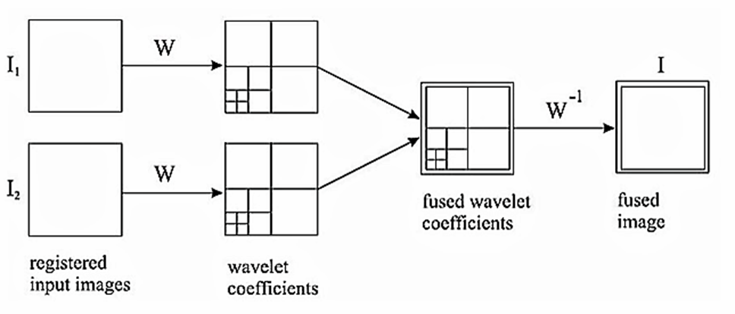
Algorithm Realization and Implementation
The wavelet coefficients of each image are taken as inputs for the Simple Average Algorithm.
The outputs of the ‘Simple Average Algorithm’ are taken as the wavelet coefficients of the output image.

Slide 11
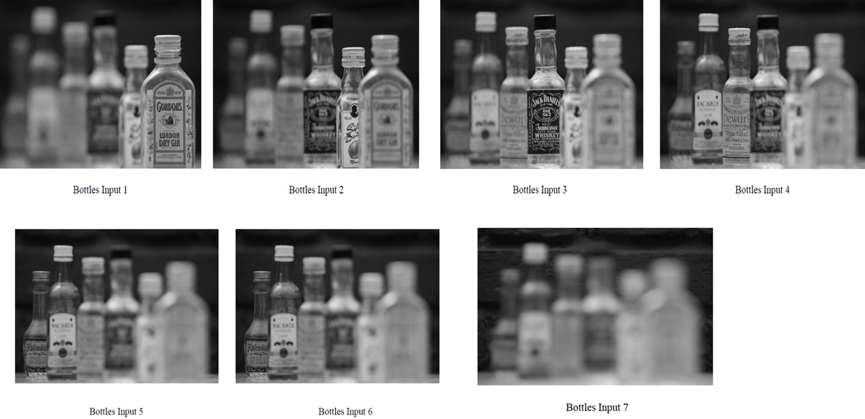
Applying the presented algorithms to the images
In this paper there are 7 images of bottles taken with 7 different planes of focus. The first six images have different bottles in focus and the seventh image has the background in focus.

Slide 12
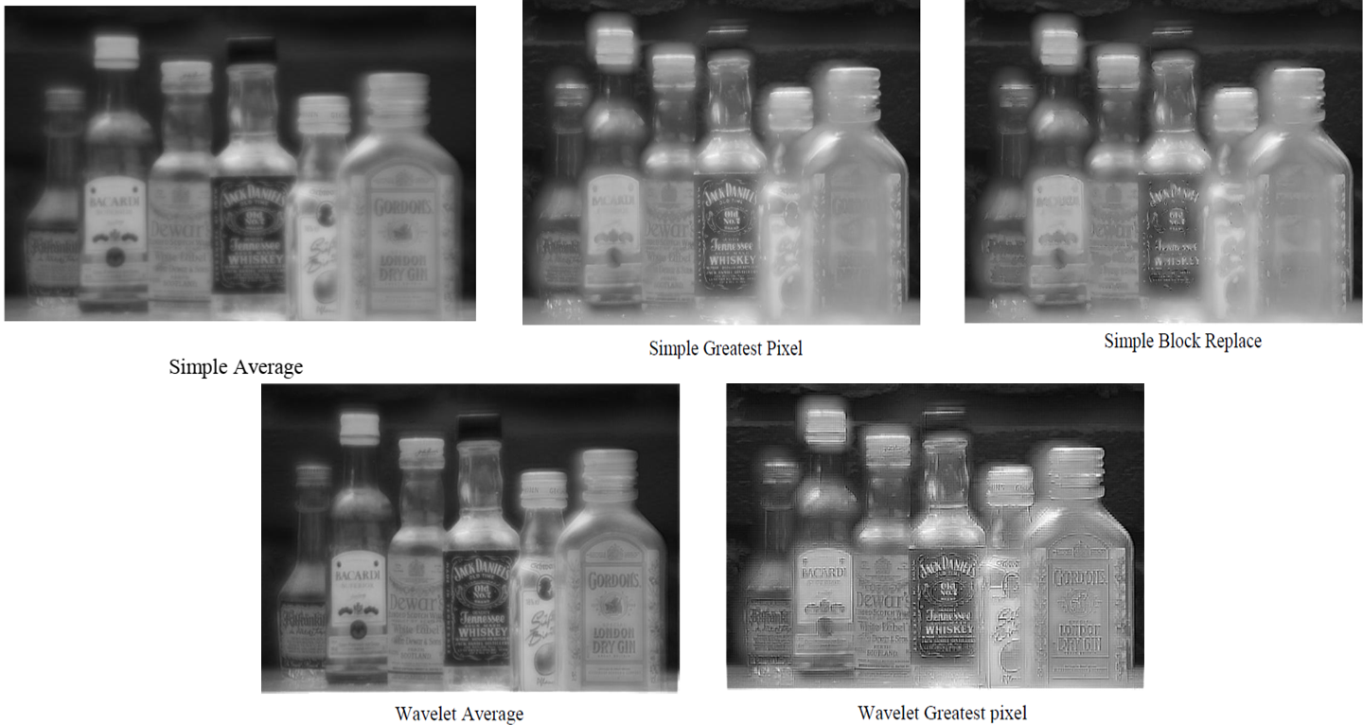

Slide 13
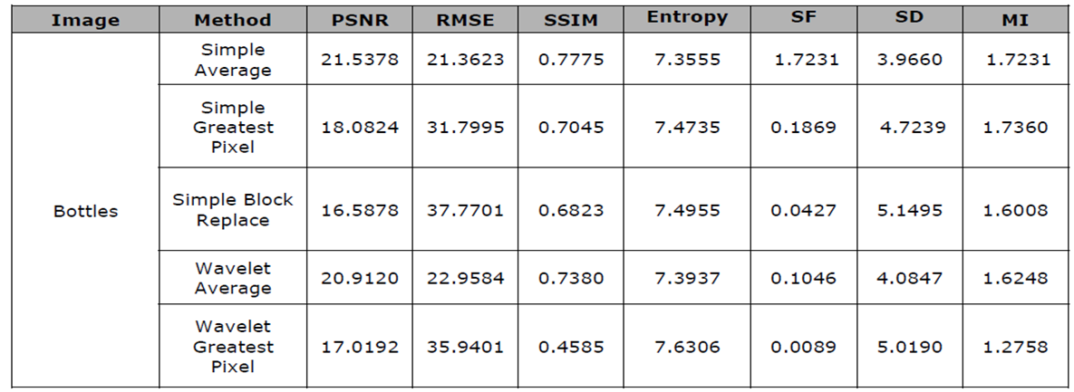
Result & Performance Analysis
On applying the Simple Average, Greatest Pixel and Block Replace algorithms:
It is observed that Simple Average gives the best result.
The Simple Average output has the highest signal to noise ratio (PSNR) and structural similarity (SSIM).
The error (RMSE) of this output is the least compared to the other two algorithms.
The labels of all the bottles can be clearly observed.
In Simple Greatest pixel the labels are a little blurred.

Slide 14
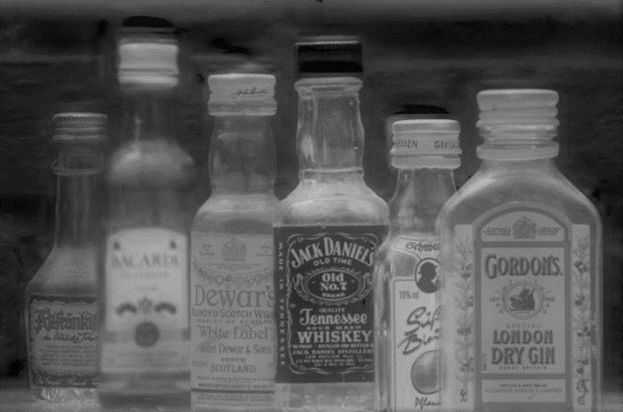
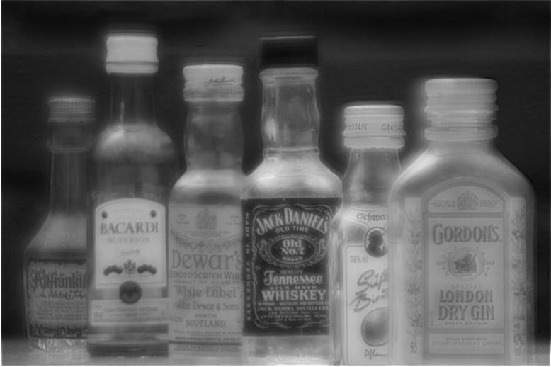
Comparison of Author Result with Mine
My Simulated Image
Resulted Image of The Article

Slide 15
Suggestions for future researches
Image fusion process should preserve all valid and useful pattern information from the source images, while at the same time not introducing artifacts.
However it is not possible to combine image without introducing some form of distortion.
Thus the Future works could be inventing methods for “decreasing” the distortion.

